Slide 1
Programming 4
06.2 Tile Map
Semester 2, 2019

Slide 2
Tiles specifically for Roguelike games

Slide 3



Implementing a tile background
Number your tiles from 0 to n
Make a layout of numbers
Translate the layout into a tile background
0 | 0 | 1 | 0
0 | 0 | 1 | 1
0 | 0 | 0 | 0
2 | 2 | 2 | 2

Slide 4
Required classes
Tile
Bitmap^ tileBitmap
State information – bool isWalkable
TileList
An array of Tile^
Methods to load and access array of Tile^
TileMap
A 2D array (the map) of indices into TileList’s array
Knows how to draw itself
Notes:
Preparing for the future

Slide 5
Implementing a tile background
TileList has an array of Tile^
TileMap has a 2D array of ints
TileMap draws itself
0 | 0 | 1 | 0
0 | 0 | 1 | 1
0 | 0 | 0 | 0
2 | 2 | 2 | 2

Slide 6
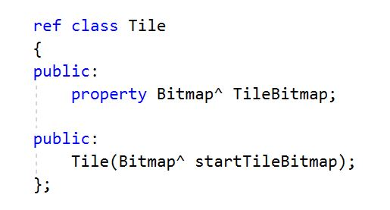
Tile class

Slide 7
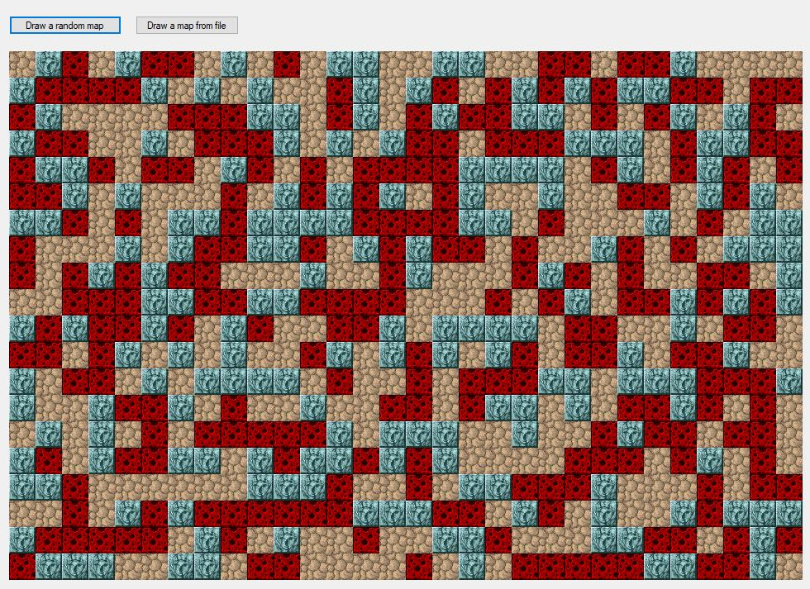
Task 1 – random map

Slide 8
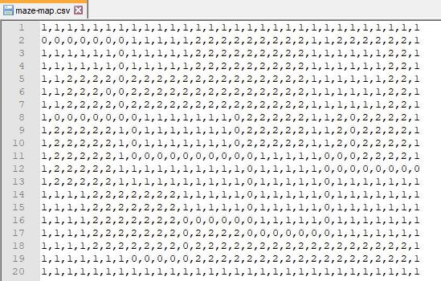
Task 2 – map from file
Notes:
Here is a CSV file you can use in development. 20 rows by 30 columns
Given the tile assignments in my code, (0 = tileOne, 1 = tileTwo and 2 = tileThree)

Slide 9
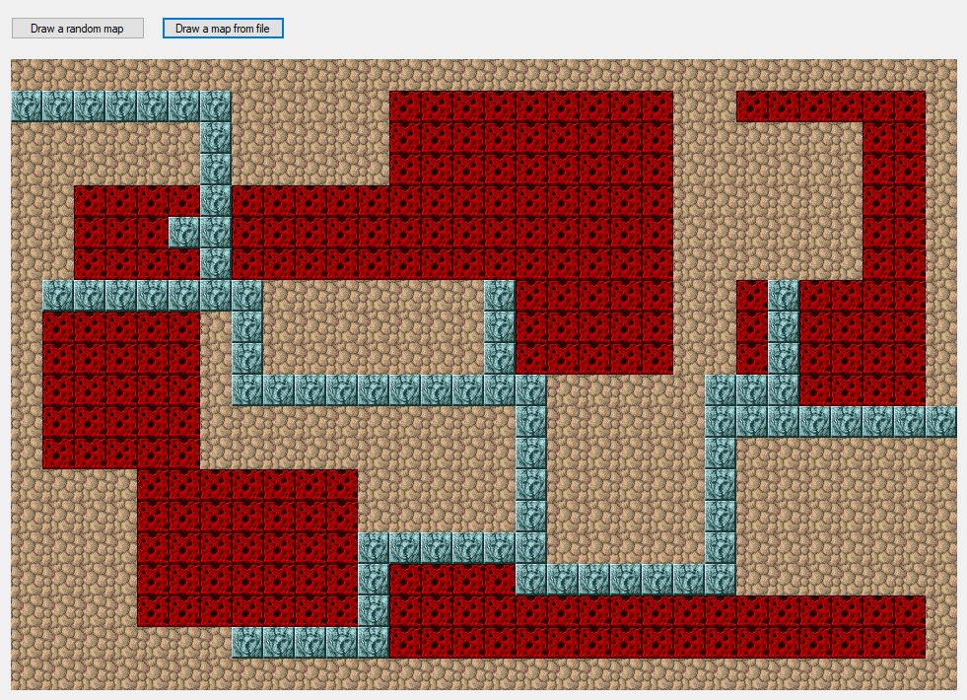
Task 2 – map from file

Slide 10
Task 2 – map from file

